Slide 1
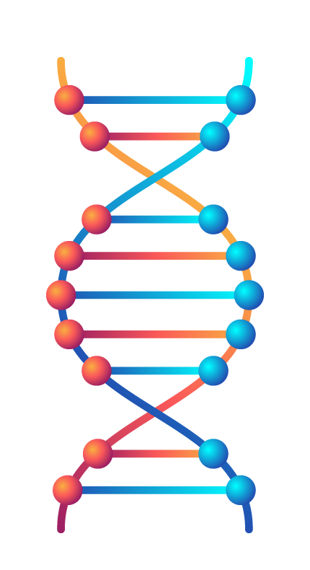
A Comparative Analysis of Machine Learning Architectures for siRNA Efficacy Prediction
Animesh Kumar (22CS30009)
Professor Pralay Mitra
Notes:
"Good afternoon, everyone. My name is Animesh Kumar, and today I will be presenting my B.Tech project, 'A Comparative Analysis of Machine Learning Architectures for siRNA Efficacy Prediction,' completed under the guidance of Professor Pralay Mitra."

Slide 2
Agenda
Introduction & Motivation
Results & Analysis
Literature Review & Research Gap
Conclusion &
Future Work
Methodology
Model Architectures
Feature Engineering
Notes:
"Here is a brief outline of what I'll be covering today.
I'll start by introducing the core problem of predicting siRNA efficacy and our motivation for this study.
Next, I'll provide a brief literature review to identify the research gap that our project addresses.
Then, I'll walk you through our methodology, covering both the extensive feature engineering pipeline and the different model architectures we implemented.
After that, I will present and discuss the results of our comparative analysis.
Finally, I'll conclude with the key takeaways from our work and suggest some promising directions for future research."

Slide 3
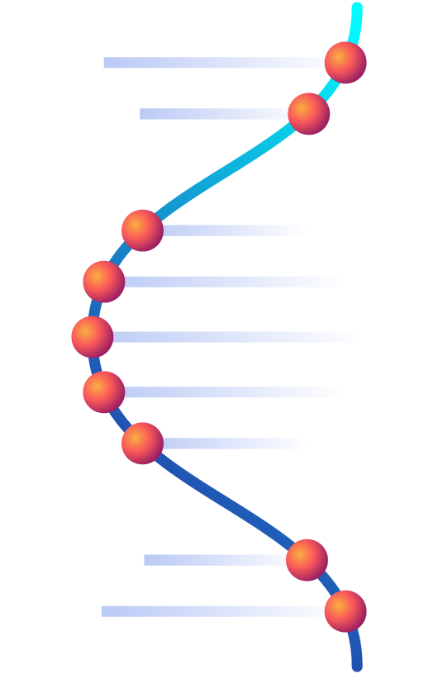
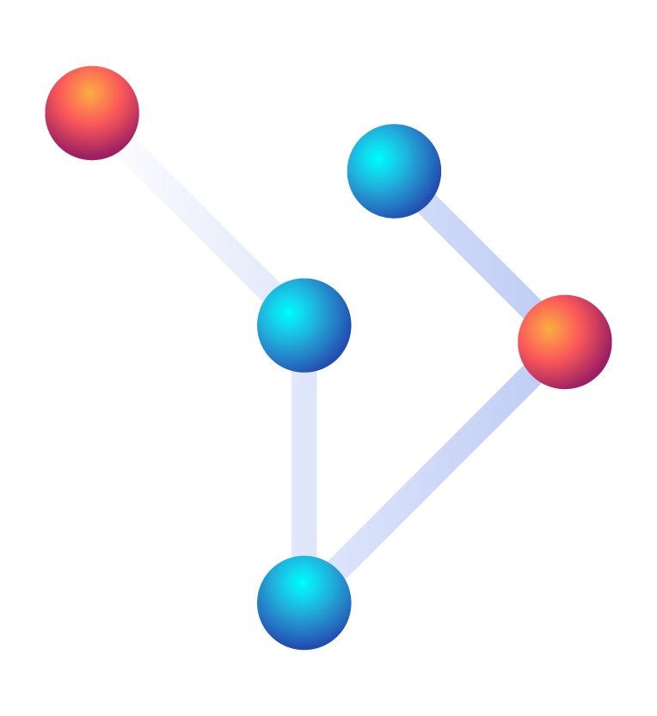
The Promise of RNA Interference
The Big Picture
Notes:
Nothings

Slide 4
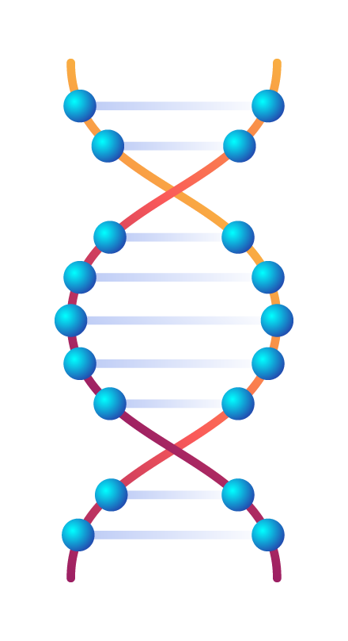
RNA Interference as a Therapeutic Tool
A diseased cell with an overactive gene.
An siRNA molecule being introduced.
The target mRNA being silenced.
A healthy cell.
A powerful, natural mechanism to selectively 'turn off' any gene of interest.
Notes:
"The world of medicine is increasingly focused on precision therapies, and one of the most promising technologies is RNA interference, or RNAi. This is a natural process where small interfering RNAs, or siRNAs, can be designed to find and destroy a specific mRNA molecule, effectively silencing a gene. This holds immense potential for treating everything from viral diseases to cancer."

Slide 5
The Central Challenge:
A Massive Search Problem
For one gene, thousands of potential siRNA candidates exist.
Efficacy varies dramatically (from >90% to <10%).
Wet-lab screening is prohibitively expensive and time-consuming.
Accurate computational prediction is a vital necessity.
Notes:
"However, this promise is bottlenecked by a major design challenge. For any single gene, we can design thousands of potential siRNAs, but only a few will be highly effective. Experimentally testing them all is not feasible. Therefore, the core problem my project addresses is the computational prediction of siRNA efficacy."

Slide 6
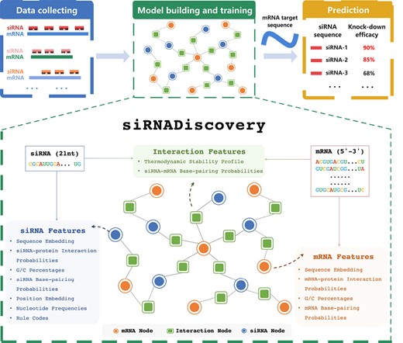
The State-of-the-Art:
Modeling Biology as a Graph
The current state-of-the-art, siRNADiscovery, uses a Graph Neural Network (GNN) to learn from the relationships between these biological entities.
The GNN creates "context-aware" predictions by passing information between the nodes.
Notes:
"Recent research has tackled this using a sophisticated approach: a Graph Neural Network. The siRNADiscovery model represents the system as a network of siRNA, mRNA, and Interaction nodes. The GNN then learns by passing messages along these connections, capturing the complex interplay between the molecules."

Slide 7
The Research Gap & Our Hypothesis
Two competing factors:
Rich Features:
  The GNN's success relies on a massive, biologically-informed feature set
(~39,000 features).
Complex Architecture:
  The GNN itself is complex, slow to train, and acts as a "black box."
Question
Hypothesis
Is the GNN's complexity necessary, or is the feature set the true driver of performance?
We hypothesize that established, interpretable machine learning models can achieve competitive performance when given the same high-quality feature set.
Notes:
"This leads to a critical question. The GNN's success is driven by both its complex architecture and its incredibly rich feature set. So, which is more important? Our project was motivated by this gap. We hypothesized that with such powerful features, simpler and more interpretable models could achieve results competitive with the complex GNN."

Slide 8

Our Experimental Approach:
A Comparative Analysis
Ensemble Models:
XGBoost
LightGBM
Random Forest
Hybrid Graph-based Model:
Spektral (GNN)
Notes:
"To test this, we conducted a rigorous comparative analysis. We faithfully reimplemented the feature engineering pipeline from the paper and evaluated four distinct model families: three powerful ensemble models—XGBoost, LightGBM, and Random Forest—and a novel hybrid approach we call the Spectral GNN model."

Slide 9
A High-Level Overview
Dataset_HUVK
Data Structuring
Results
Feature Engineering
Model Training & Evaluation
The same feature set was used for all models; only the data structure and model architecture were changed.
Notes:
"Our methodology was straightforward. We started with the standard HUVK dataset, applied the comprehensive feature engineering pipeline, and then structured the data in different ways for each model before training and evaluating them on a standardized set of metrics."

Slide 10
Feature Engineering:
The Foundation of Prediction
Four quadrants, each with a list of features:
Sequence Features: One-Hot Encoding, Positional Embedding
Structural Features: Base-Pairing Probabilities (Self-fold, Co-fold)
Biophysical Features: Thermodynamic Stability, RNA-AGO2 Interaction
Empirical Rules: k-mer Frequencies, G/C Content, Rule Codes
Notes:
"The foundation of this entire project is the rich feature set. We didn't just use raw sequences; we engineered features across four key categories: sequence-level information, predicted RNA structures, biophysical properties like thermodynamic stability, and established empirical rules from biological literature."

Slide 11
Data Structuring for Different Architectures
For Ensemble Models (XGBoost, LGBM, RF)
For the Spektral (GNN) Model
Flattened Feature Matrix
1. Feature Aggregation: All features are collected:
siRNA-specific features
mRNA-specific features
Interaction-specific features
2. Concatenation: For each siRNA-mRNA pair, these features are combined into a single, long feature vector.
3. Result: A single, large tabular matrix where each row is an experiment and each column is a feature.
Dimensions: (Number of Samples) x (~39,000 Features)
Hybrid Graph-Tabular Method
Graph Construction: First, a heterogeneous graph is built to represent the relationships between all siRNA, mRNA, and Interaction nodes.
Spektral embeddings are generated to convert the graph's structure into new features.
Result: An augmented tabular matrix that is fed into an XGBoost model.
Notes:
"A key part of our work was structuring these features for each model. For the standard ensemble methods, we flattened all ~39,000 features into a single tabular matrix. For our hybrid Spectral GNN model, we first constructed the graph, used its structure to generate new 'spectral embedding' features, and then added these to the flattened matrix before training. This allowed us to test if the graph's topology, by itself, adds predictive power."

Slide 12
Results: Overall Performance
Model | PCC ↑ | SPCC ↑ | MSE ↓
Spektral (GNN) | 0.7290 | 0.7252 | 0.0228
LightGBM | 0.7178 | 0.6998 | 0.0221
XGBoost | 0.7107 | 0.7001 | 0.0225
Random Forest | 0.6766 | 0.6592 | 0.0249
AUC ↑
0.8480
0.8314
0.8364
0.8108
The Spectral (GNN) model is the best-performing among our implementations, with LightGBM as a close second.
Notes:
"Now for the results. This table summarizes the average performance of all models across the three data splits. The original GNN is included as a state-of-the-art baseline. As you can see, our hybrid Spectral GNN model achieved the highest correlation and AUC scores among our implementations, while LightGBM was highly competitive and achieved the lowest Mean Squared Error."

Slide 13
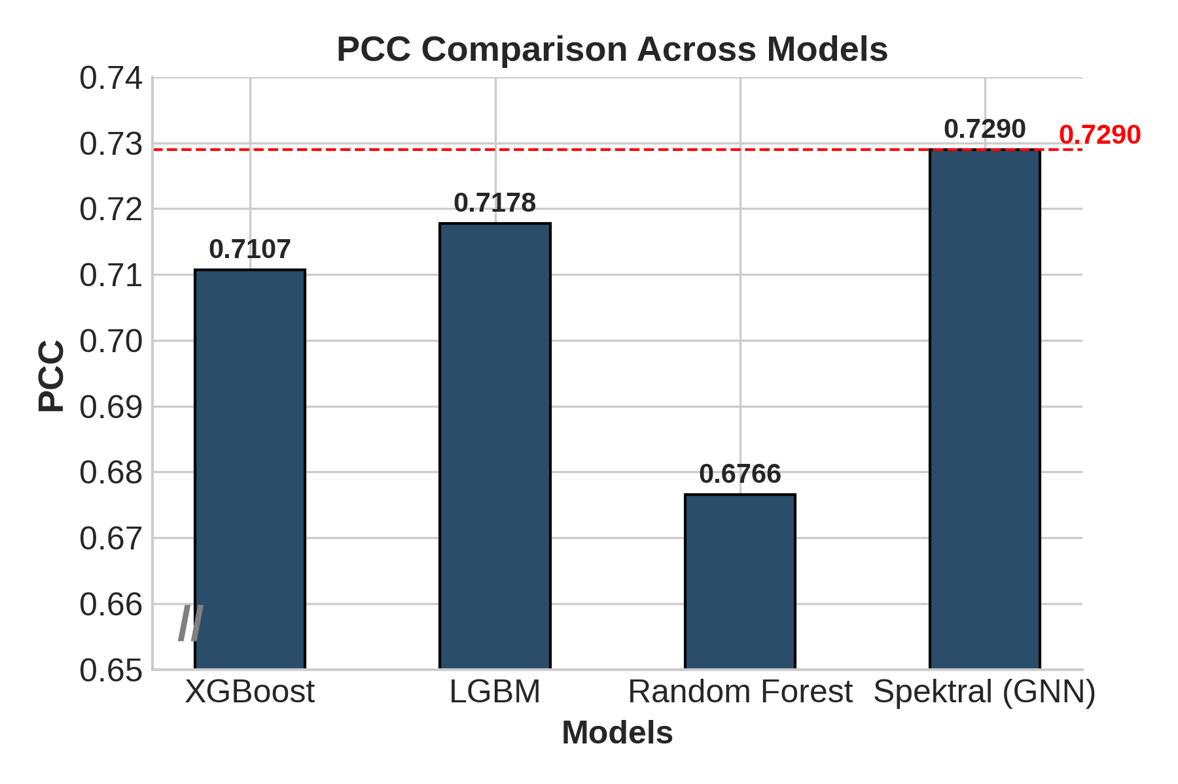
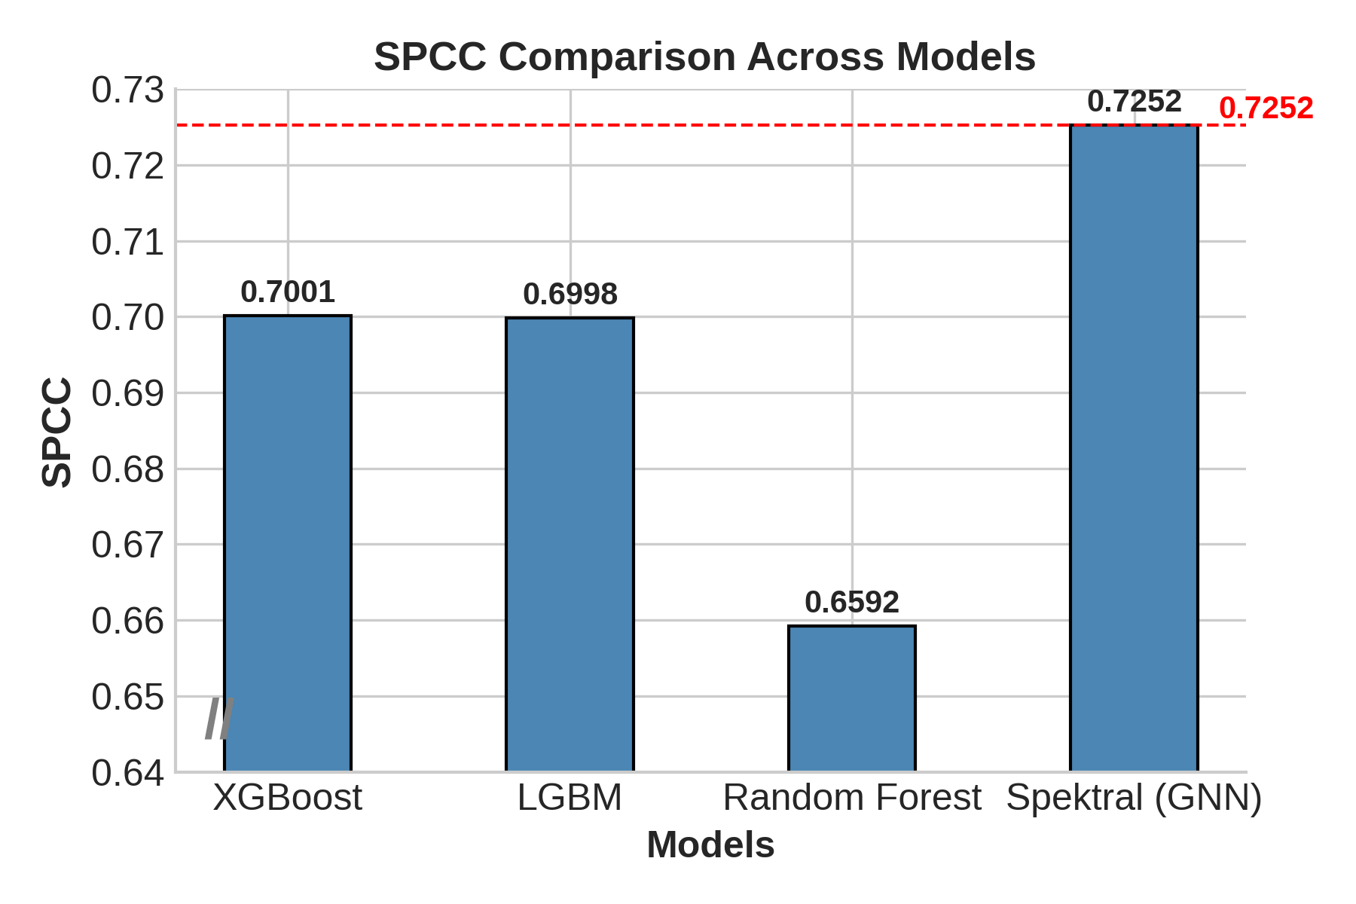
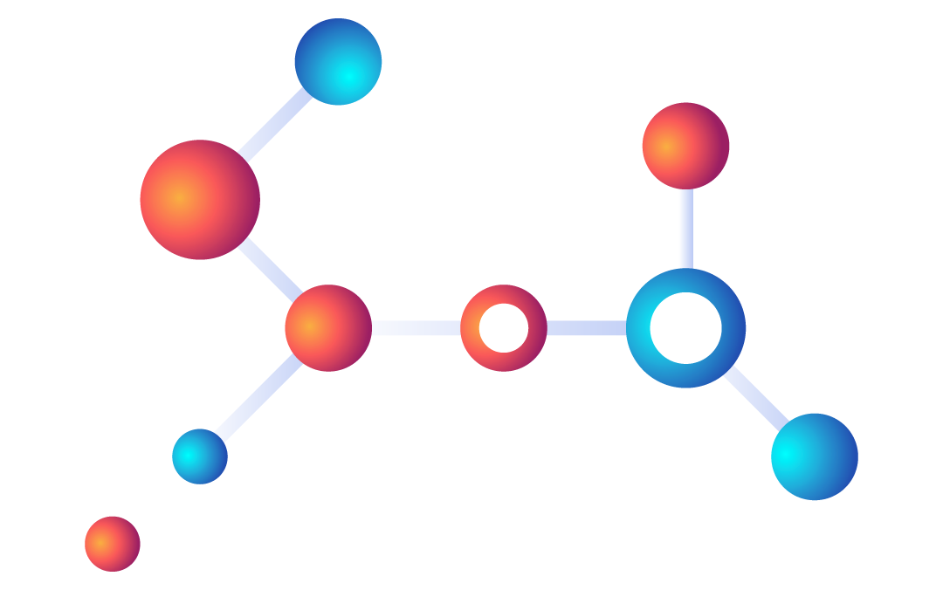
Analysis by Metric: Correlation
The Spektral (GNN) model is the clear winner, demonstrating that encoding the graph's topology as features significantly improves the model's ability to correctly rank siRNAs.
Notes:
"Looking first at correlation, which is crucial for a regression task, the PCC and SPCC plots clearly show the superiority of our Spectral GNN approach. This strongly suggests that the graph's structure contains valuable predictive information that helps the model rank the siRNAs more accurately."

Slide 14
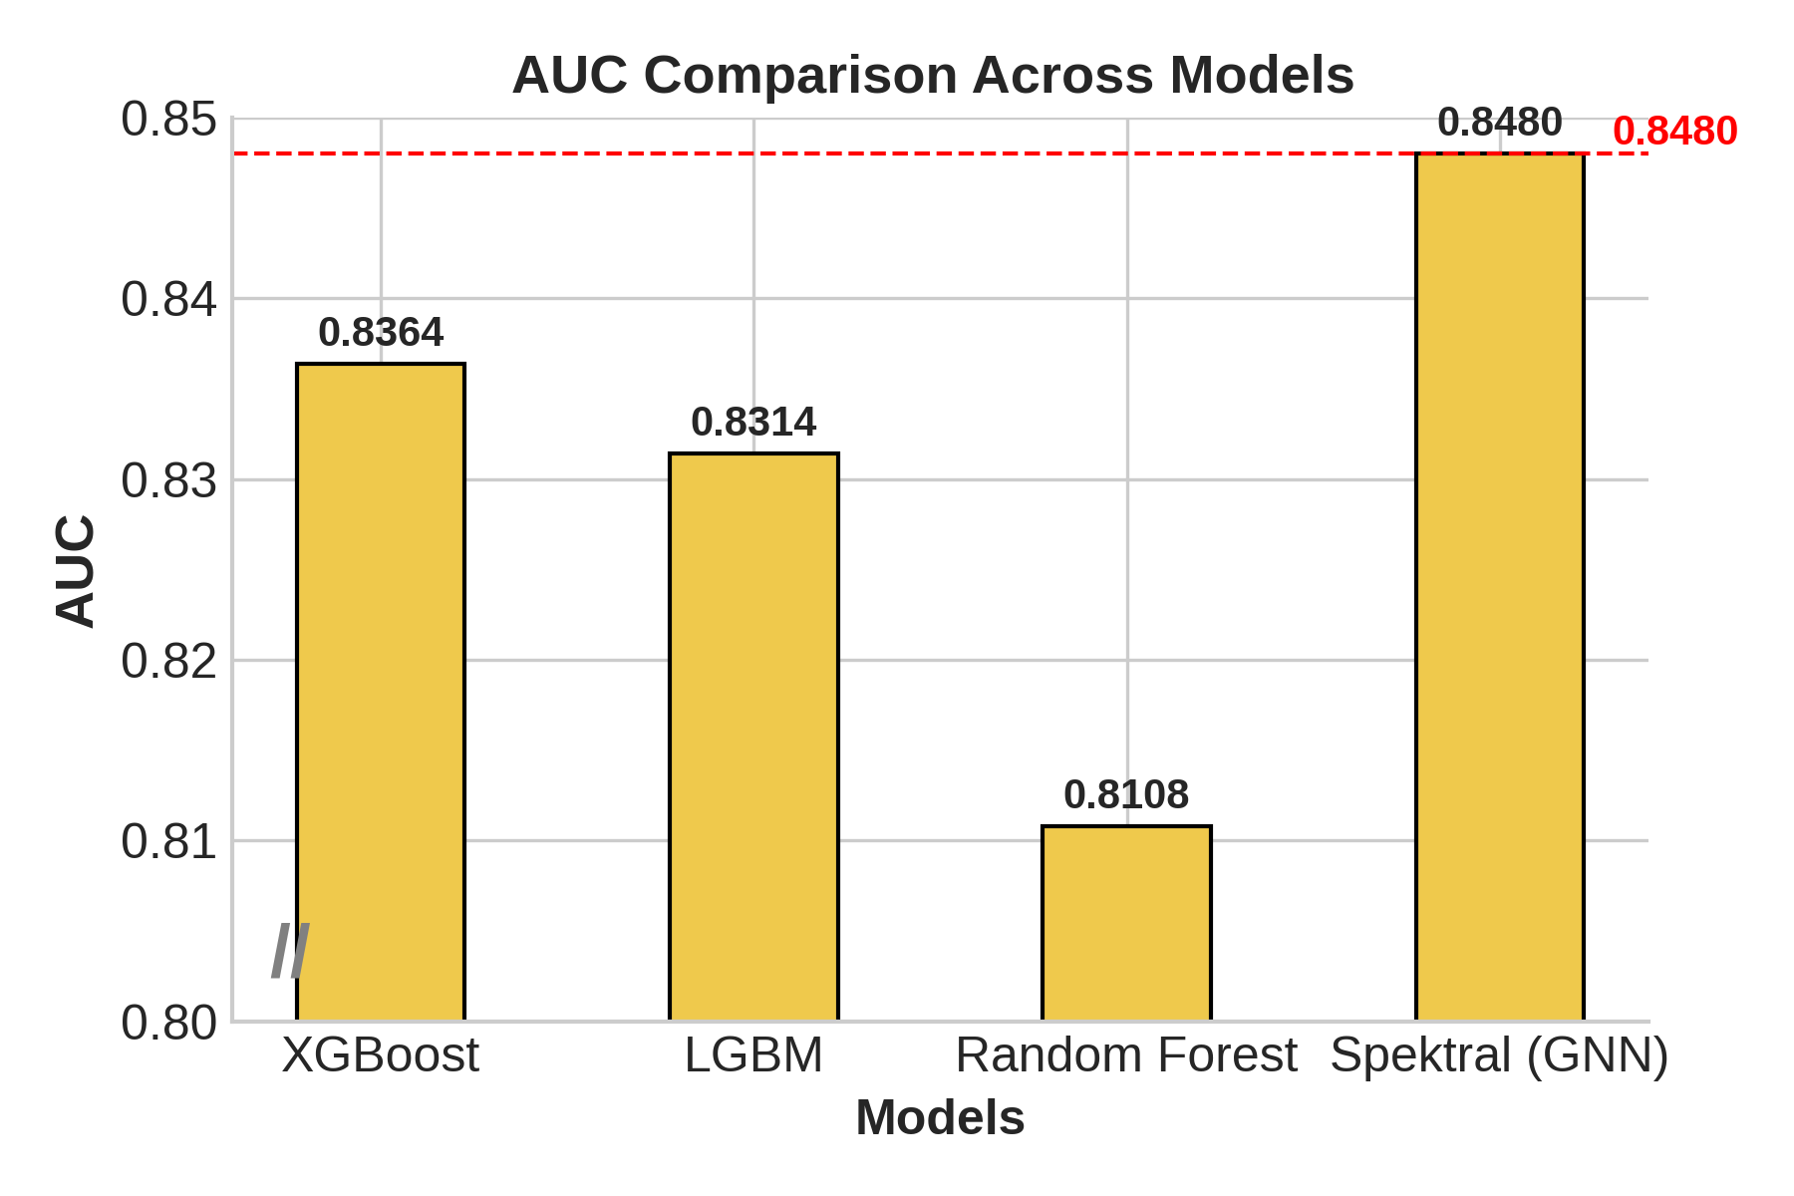
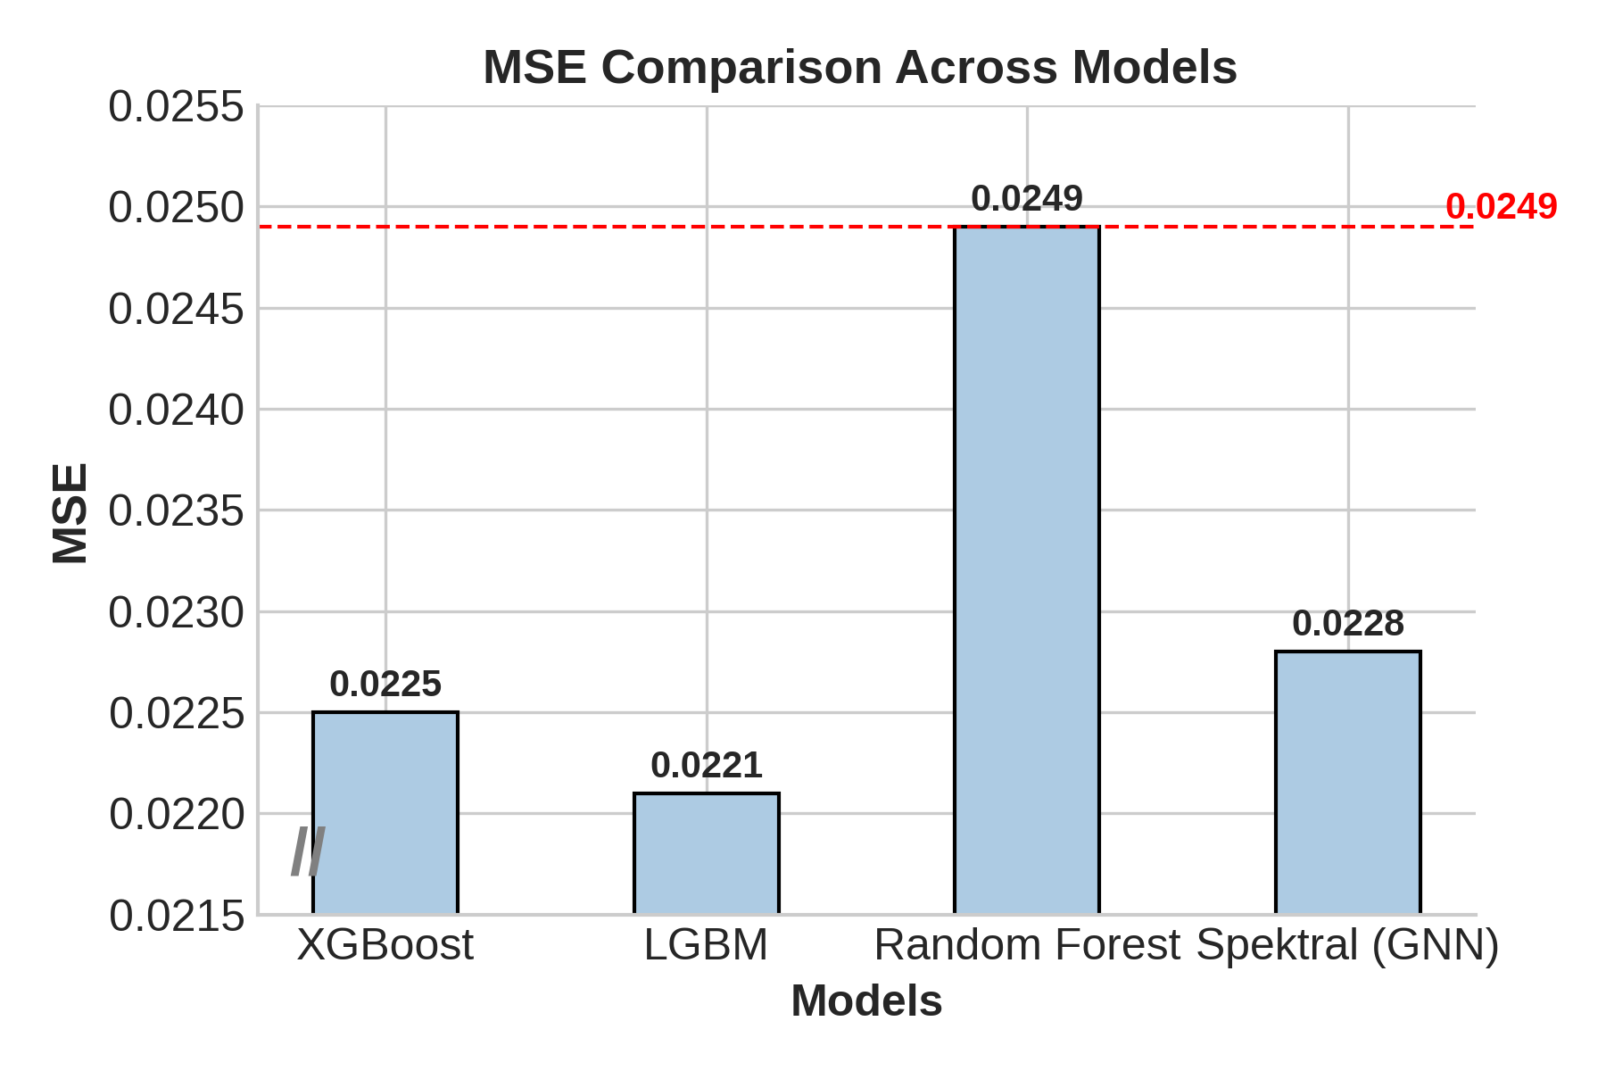
Analysis by Metric: Prediction Error (MSE) & Classification (AUC)
The results are much closer on this metric.
LightGBM achieves the lowest error (best performance).
The Spectral (GNN) model is again the top performer.
Standard XGBoost and LightGBM are also strong classifiers.
Notes:
"When we look at the other metrics, the story becomes more nuanced. For Mean Squared Error, LightGBM actually performs the best, suggesting a trade-off: the spectral features that help so much with ranking might add a small amount of variance that slightly increases the average prediction error.
"However, when we evaluate the models on their ability to classify siRNAs as effective or ineffective using the AUC metric, the Spectral GNN once again emerges as the strongest performer. This demonstrates its all-around robustness for both ranking and classification tasks."

Slide 15
Key Findings & Analysis
Graph Structure Boosts Performance
Ensemble Models are Highly Competitive & Practical
The Advantage of Interpretability
Observation:
Adding graph-derived spektral features to the XGBoost model significantly improved its predictive power.
Result:
The Pearson Correlation Coefficient (PCC) increased from 0.711 (standard XGBoost) to 0.729 (Spectral-GNN).
Conclusion:
This directly demonstrates that the underlying network topology contains unique and valuable predictive information that is not captured by the node features alone.
Observation:
Standard gradient boosting models, without any graph information, performed exceptionally well.
Result:
LightGBM achieved a PCC of 0.718, very close to the more complex Spectral model's 0.729, and delivered the lowest overall MSE.
Conclusion:
For practical applications, a well-tuned ensemble model on a flattened feature set offers a powerful and efficient solution with less implementation overhead.
Key Insight:
Unlike "black-box" deep learning models, ensemble methods like XGBoost and Random Forest can rank the importance of every feature.
Significance:
This allows us to identify the specific biological factors that are most predictive of siRNA efficacy.
Conclusion:
This interpretability provides direct, actionable insights for scientific discovery, which is a crucial advantage for any model used in a biological context.
Notes:
"Our analysis led to three key findings.
"First, we found that graph structure provides a measurable performance boost. By adding spectral features derived from the graph's topology to our XGBoost model, we saw a clear increase in correlation. This proves that the network structure itself contains valuable predictive information.
"Second, despite this, standard ensemble models proved to be highly competitive and practical. LightGBM, with no graph information at all, achieved a PCC of nearly 0.72 and had the lowest overall error, making it a powerful and efficient alternative.
"Finally, and perhaps most importantly, the ensemble models offer a crucial advantage: interpretability. Unlike a black-box GNN, models like XGBoost can tell us exactly which biological features are driving the predictions. This ability to extract actionable scientific insights is a major benefit of this approach."

Slide 16
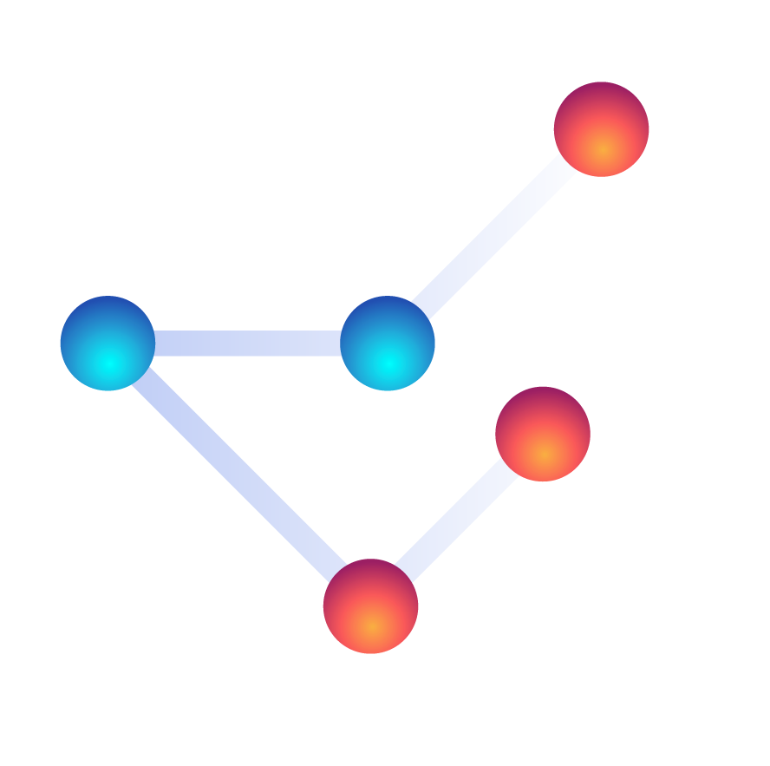
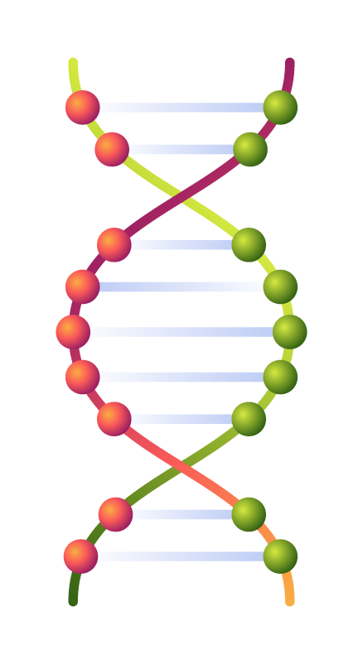
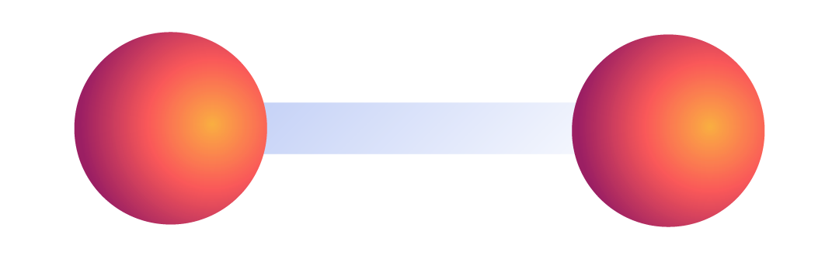
Conclusion
This project successfully compared four distinct ML architectures for siRNA efficacy prediction.
The hybrid Spektral (GNN) model achieved the highest correlation, demonstrating the value of graph structural information.
Standard gradient boosting models (LightGBM/XGBoost) are highly competitive, offering a powerful and practical alternative with less complexity.
Ensemble models provide crucial interpretability through feature importance, a key advantage for scientific discovery.
Notes:
"In conclusion, our systematic comparison has yielded several key insights. We've shown that incorporating graph topology as features provides a measurable performance benefit, with our Spectral GNN being the top performer. However, we also found that standard gradient boosting models are a highly competitive and practical alternative, offering the significant advantage of interpretability. This highlights a clear trade-off between absolute performance and model simplicity."

Slide 17
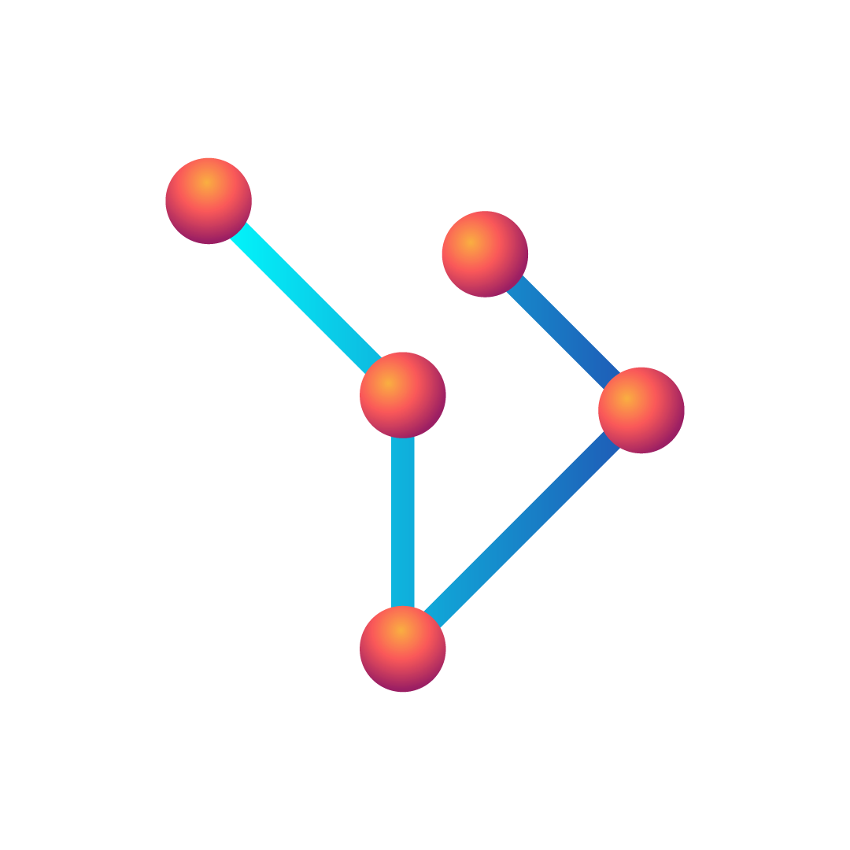
Future Work
Advanced Hyperparameter Optimization: Use frameworks like Optuna to systematically tune all models and potentially close the performance gap with the SOTA baseline.
Deeper Investigation into GNNs: Explore more advanced GNN architectures like Graph Attention Networks (GATs).
Feature Selection: Use the feature importance rankings from our models to conduct a feature selection study to create smaller, more efficient models.
External Validation: Test the generalizability of all models on the external Simone and in-house (ACON) datasets.
Notes:
"This work opens up several exciting avenues for future research. The most immediate steps would be to perform advanced hyperparameter optimization on our top models, conduct a feature selection study based on our findings, and finally, validate all our models on external datasets to ensure their robustness."

Slide 18
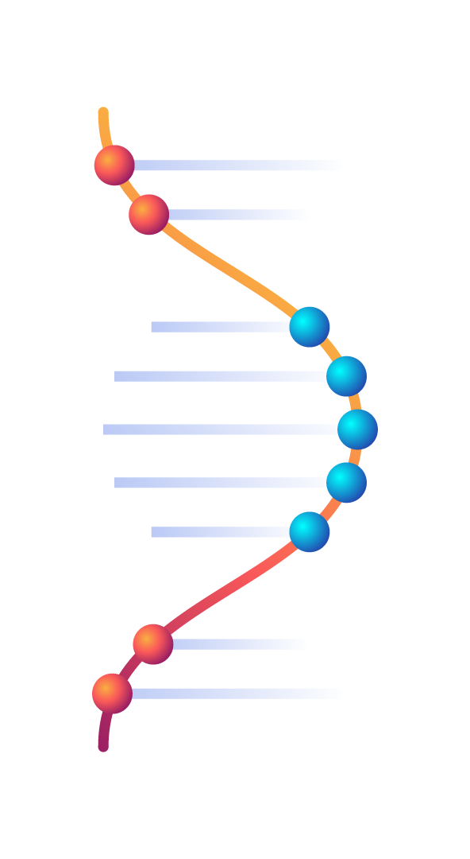
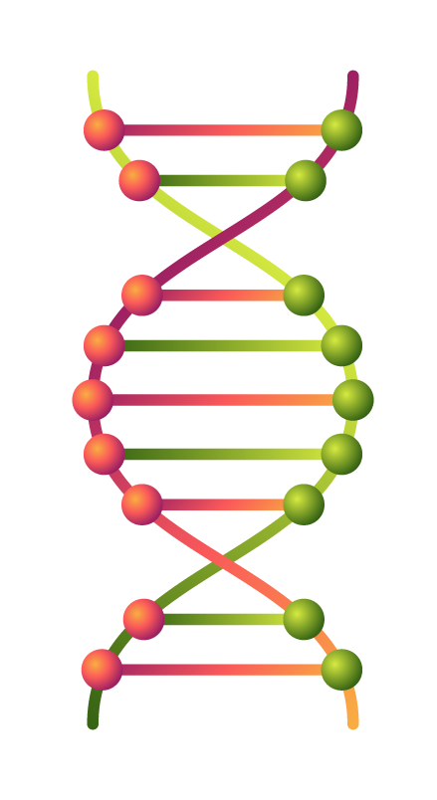
Thank You
Notes:
This can be the part of the presentation where you introduce yourself, write your email…
Special thanks to Prof. Pralay Mitra for his invaluable guidance.
Thank you for your attention.

Slide 19
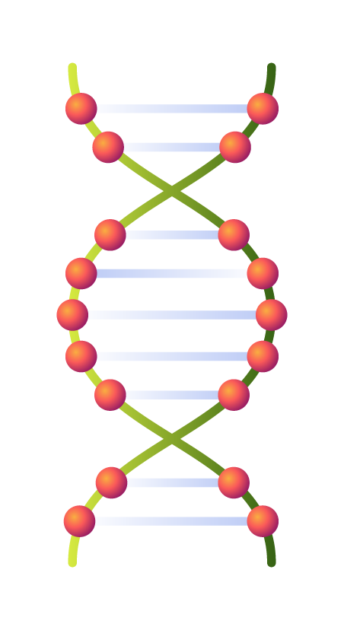

Question Answer
Notes:
I would now be happy to answer any questions.

